Slide 1
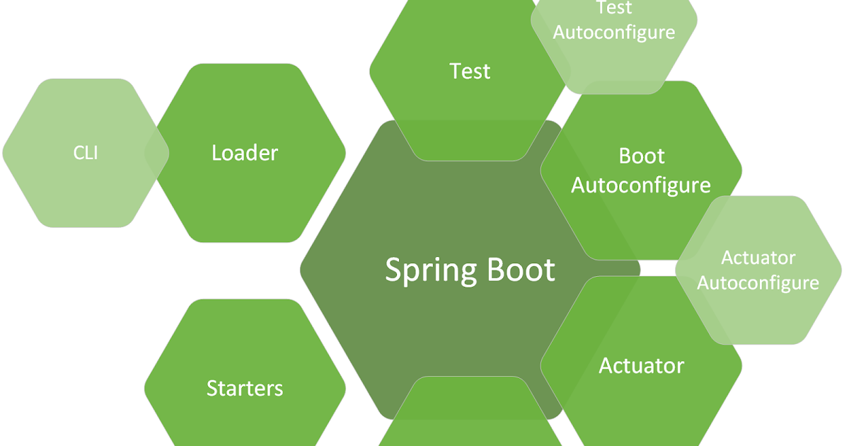

Spring Data JPA
PagingAndSortingRepository

Slide 2

Different repositories which we are going to discuss during Spring Data JPA learning.
org.springframework.data.repository
Repository<T,ID>
CrudRepository<T,ID>
PagingAndSortingRepository<T,ID>
org.springframework.data.repository.query
QueryByExampleExecutor<T>
org.springframework.data.jpa.repository
JpaRepository<T,ID>

Slide 3
PagingAndSortingRepository<T,ID> extends CrudRepository<T,ID>
In this repository we have two new finder methods
Page<T> findAll(Pageable pageable)
Iterable<T> findAll(Sort sort)
Page is an interface extends another interface Slice
Important method available in Page
long getTotalElements()
int getTotalPages()
List<T> getContent()

Slide 4
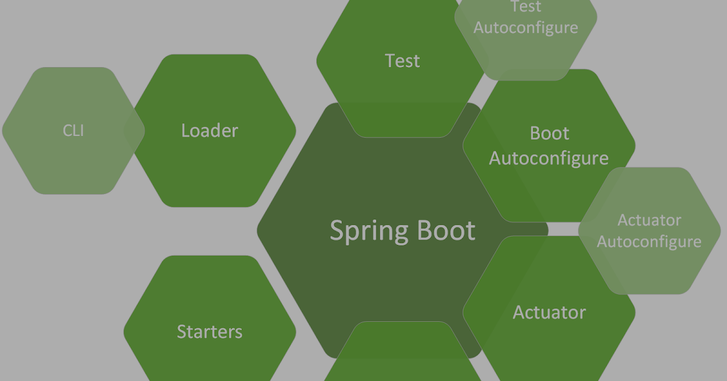
Important methods of PageRequest (Pageable type)
static PageRequest of(int page, int size)
static PageRequest of(int page, int size, Sort.Direction direction,String... properties)
static PageRequest of(int page, int size, Sort sort)
Project Setup
Dependency
Spring Web
Lombok
Spring Data JPA
Spring Boot DevTools
MySQL Driver
Or
H2 Database

Slide 5
application.properties - H2 DB
spring.datasource.url=jdbc:h2:mem:h2db
##Incase you want to use file for H2 DB then comment above and uncomment below
##spring.datasource.url=jdbc:h2:file:path/database_name.db
spring.datasource.driver-class-name=org.h2.Driver
spring.datasource.username=admin
spring.datasource.password=admin
spring.h2.console.enabled=true
##########JPA properties#############
spring.jpa.show-sql=true
spring.jpa.hibernate.ddl-auto=update
One step deeper to project
com.reed.dao.entities
Entities are classes for which corresponding table either created or exists into DB.
com.reed.dao.repos
Repository are used to manage entities by using different set of CRUD methods.
com.reed.service
Service layer which will make use of repo to persist entity data into underlying DB.
com.reed.controller
Rest controller will act as front layer to route the request to service and respond to client.

